Slide 1
Progress Report RC in NLS
Abrari N H
14 March 2022

Slide 2

Main Difference from Previous Work
Using Reservoir with Real Number
Shorter Training Data: 8000 timesteps, (4s in NLS time)
Using $L_{2}$ norm instead of $H^{1}$

Slide 3
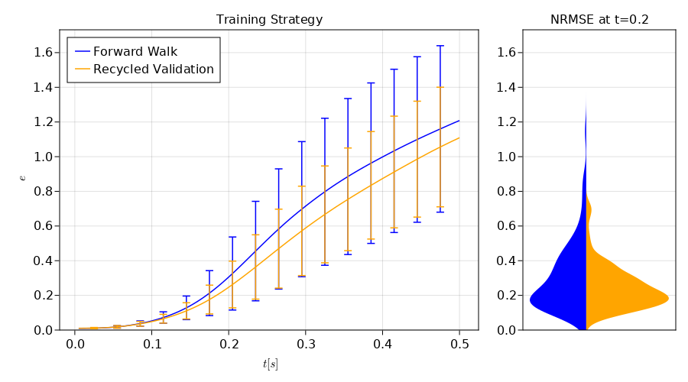
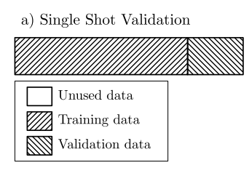
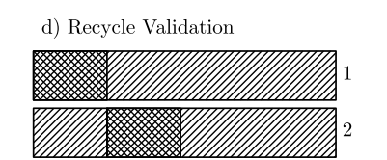
Train Strategy
(Racca, 2021)

Slide 4
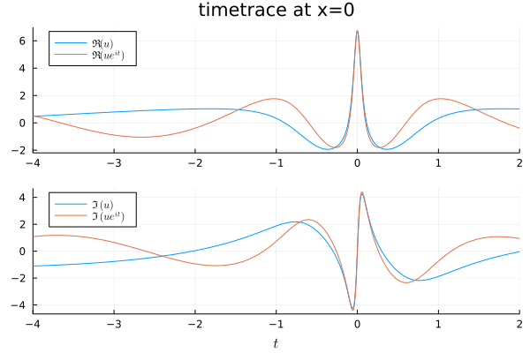
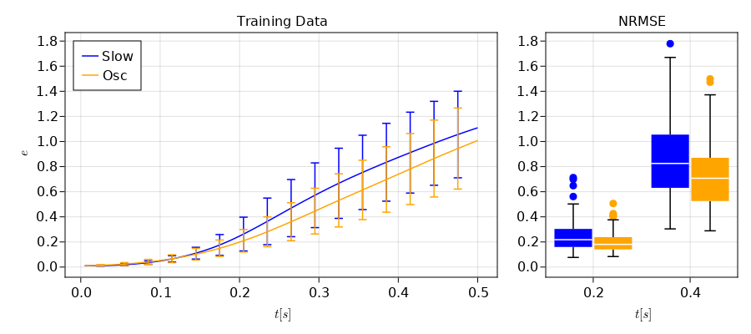
Different Training Data

Slide 5
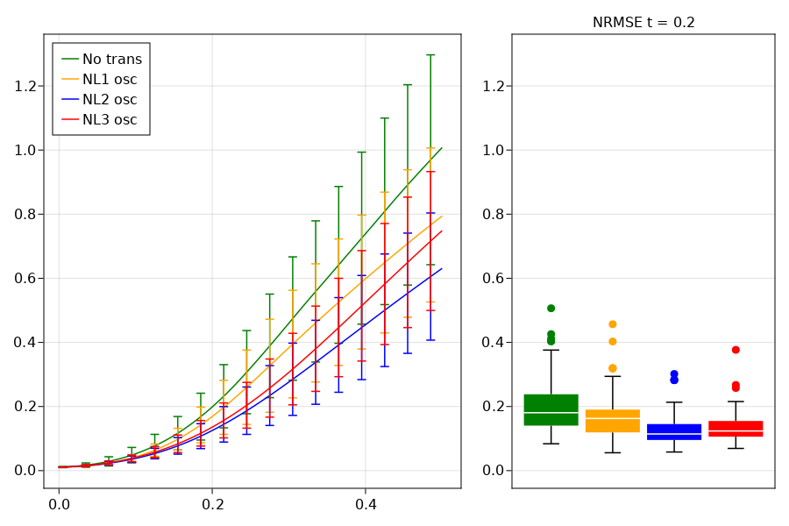
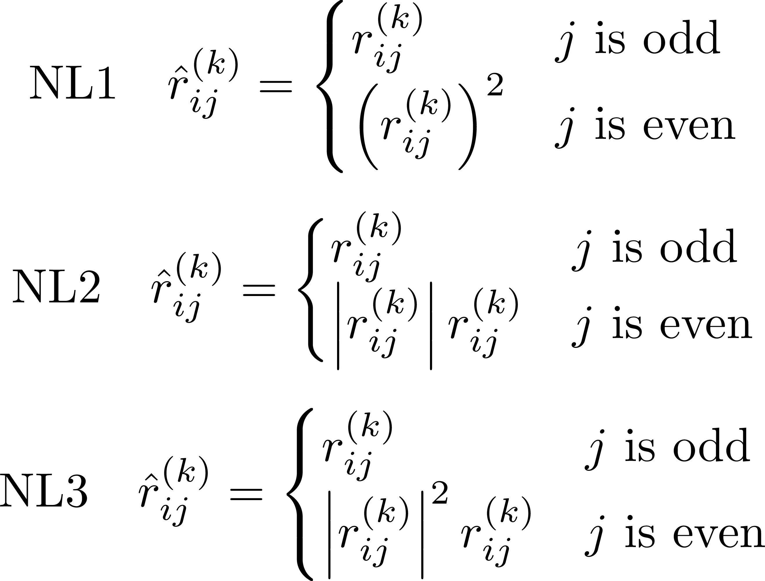
Different NLT

